Slide 1
Use Cases
Jie Zheng
Department of Genetics
University of Pennsylvania

Slide 2
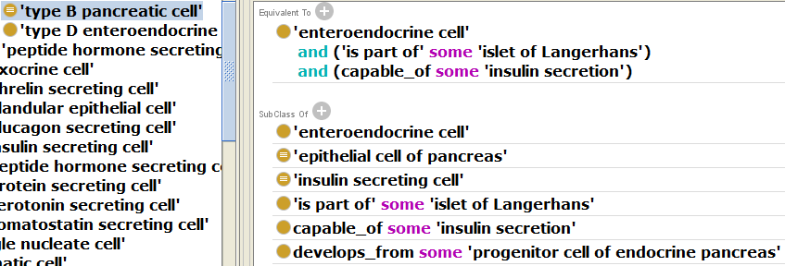
Cell – part of some anatomical entity
type B pancreatic cell (a native cell)
Islet cell autotransplantation
removes pancreas from patient, isolates insulin-producing cells from the pancreas and then these cells are then returned to liver of the patient
Not part of islet of langerhans/pancreas

Slide 3
Cell – develop from some cell
beta cells generated from other paths
From stem cell
From mature cell of other type, like liver
not beta cell in the view of developmental lineage
In these cases, use ‘at some time’ or ‘at all time’?
Or if not meet logical definition, then we will say they are not pancreatic beta cell
Notes:
Native cell:
A cell that is found in a natural setting, which includes multicellular organism cells 'in vivo' (i.e. part of an organism), and unicellular organisms 'in environment' (i.e. part of a natural environment).

Slide 4
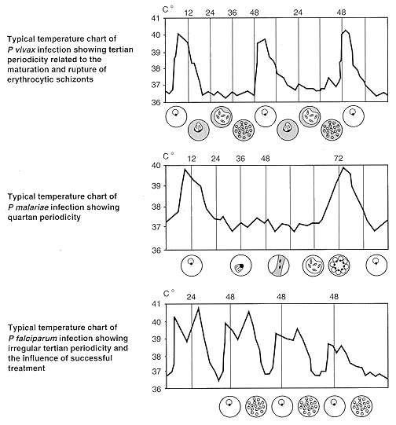
Temperature charts of some parasite infected diseases
How to represent it using BFO 2.0
Process pattern
Or process profile
And how to associate it with parasite life cycle

